Slide 1
Soft drinks presentation
Student’s Name
Institutional Affiliation

Slide 2
Introduction
The product chosen for this presentation is soft drinks under the category of fast drinks.
The presentation shows how soft drinks are advertised including the ethical standards in advertising, its effects on the American culture, techniques used in advertising and critical issues arising from various areas.
The presentation also gives an example of a commercial (taste the feeling) and analysis it.

Slide 3
Who determines ethical standards for advertising?
The Institute for Advertising Ethics (IAE) which is administered by the American Adverting Federation (AAF) is a body that determines the ethical standards for advertising in America including advertisements of soft drinks.
The main purpose of AIE is to inspire advertising, marketing communications, public relations professionals to practice the highest personal ethics in the creation and distribution of information to consumers.
IEA articulates the ethical principles and practices for advertising, awards companies and professionals with enhanced advertising ethics among other purposes.
This body has stipulated principles that define how various forms of communication interrelate with what is right for consumers.
Notes:
Just like other products, advertisements for softs drinks are regulated and controlled by the Institute for Advertising Ethics (IAE) in the US. This body is administered by the American Advertising Federation (AAF). The body inspires advertising, marketing communications and public relations professionals to practice the highest personal ethics in the creation and distribution of information to consumers. The body stipulates principles that regulate advertisement and what is right for consumers.

Slide 4
In what ways has advertising affected American culture?
Advertising has affected American culture by normalizing the values and behaviors of people.
Advertising has changed the spending habits of most Americans.
Advertising also promotes choice and reflect the existing cultural values. Advertising has encouraged many Americans to save less and borrow mores and work harder in order for them to get the goods of their choice.
Notes:
Advertising has affected American culture by affecting the values of American culture. Advertisement normalizes the values and behaviors. Advertising has changed the spending habits of most Americans. Many people spend a lot of money as they change from one brand to another as a result of advertisement. For example, consumers spend a lot trying products from Coca Cola and Pepsi. Advertising has encouraged many Americans to save less and borrow mores and work harder in order for them to get the goods of their choice.

Slide 5
Key persuasive techniques used in consumer advertising of soft drinks
Feeling and emotions
Soft drink companies like coca cola use the feelings and emotions to lure customers to buy their products.
For example, the Coca Cola “Taste the feeling” ad targets the feelings and emotions of the millennial generation.
The advert shows wonderful moments of friendship and excitement after tasting the Coca Cola drink.
Notes:
Many advertisements aim at winning the audience to buy the advertised product. They can do so in many ways. The first way is by arousing the feelings and emotions of the consumers. For soft drink companies like Coca cola, some ads are intended to arouse the feelings of consumers. In one of the company’s adverts dubbed “Taste the feeling” the advert arouses the feelings of joy, excitement and love. The advert shows wonderful moments of friendship and excitement after tasting the Coca Cola drink. Thus, the audience is tempted to take the drink so that they can have the same feeling like that of the advertisers.

Slide 6
Cont…
The advert shows how Coca Cola is there in everyone’s life especially the Millennials.
The drink is portrayed to bring moments of love, friendship, and fun, thus the company targets the youth to take the dink to enjoy themselves.
In the advert, a girl is skiing and some friends are having fun together. A guy is later seen kissing a girl which brings a nostalgic feeling and miss moments of love and fun. This prompts the viewer/customer to buy the drink to enjoy such moments.

Slide 7
Health and nutrition
Most of the adverts for soft drinks are used to portray how healthy the drinks are.
The ads show how it is healthy to take the drinks because the drinks are nutritious and promote the health of the customer.
The adverts show how the drink is not associated with diseases like cancer or diabetes and other conditions like obesity.
For example, Robinson’s new ad “Natural break” by Saatchi and Saatchi London promotes its refreshed variant for health-conscious and on the go consumers.
Notes:
Health is a concern for everyone. Everyone takes into consideration their health before taking any food o drinks. In the wake of many diseases like diabetes, cancer, obesity and other diet related diseases, people are very careful not to take drinks or food that can cause such diseases. Most of the soft drink adverts show how such drinks are healthy and nutritional to our bodies although it may be exaggerated or necessarily true. The adverts show how the drink is not associated with diseases like cancer or diabetes and other conditions like obesity. For example, Robinson’s new ad “Natural break” by Saatchi and Saatchi London promotes its refreshed variant for health-conscious and on the go consumers.

Slide 8
Endorsements
This is where companies use the images of celebrities or prominent people to promote their products.
Such people may be prominent footballers, tennis players, athletes, and boxers.
Since people are familiar with celebrities and wish to emulate them, consumers might be moved to listen to and trust those “stars” about a product.
Notes:
The use of celebrities is another technique used in consumer advertising. People tend to use the products that these “stars” or idols use. These celebrities include rominent footballers, tennis players, athletes, and boxers. Since people are familiar with celebrities and wish to emulate them, consumers might be moved to listen to and trust those “stars” about a product.

Slide 9
Solutions
Most of the advertisers seek to show consumers that they have the answers to the problems.
In a world riddled with problems, adverts want to convince the consumers that they have the answers to the problems.
For example, the Coca Cola’s advert “Taste the feeling” tries to show how the youth can avoid boredom and bring moments of joy, fun and refreshment.
The advertised product comes to the rescue of the problem especially by taking the advantage of the desperate consumer.
Notes:
In a world riddled with problems, adverts want to convince the consumers that they have the answers to the problems. For example, the Coca Cola’s advert “Taste the feeling” tries to show how the youth can avoid boredom and bring moments of joy, fun and refreshment. The solution to boredom according to this ad is taking a coca cola drink. The advertised product comes to the rescue of the problem especially by taking the advantage of the desperate consumer.

Slide 10
Children and advertising of soft drinks
Advertising has many effects on children’s diet and diet-related health.
Advertisement of fast foods has been associated with obesity and overweight of kids in the United States.
Most of the beverage ads targeting children promote sugar and caffeine and not health.
Soda giants like Coca-Cola and Pepsi target children via “child-friendly advergame apps” like Fanta Fruit Slam.
Soft drinks companies have agreed not to advertise any drinks with high sugar content to under 16s across all media channels, including online. The ban aims to tackle childhood obesity.
Notes:
Children are very sensitive to advertisements due to their young minds and their inability to discern the good and the bad. Most of the beverage ads targeting children promote sugar and caffeine and not health. Soda giants like Coca-Cola and Pepsi target children via “child-friendly advergame apps” like Fanta Fruit Slam. Soft drinks companies have agreed not to advertise any drinks with high sugar content to under 16s across all media channels, including online. The ban aims to tackle childhood obesity.

Slide 11
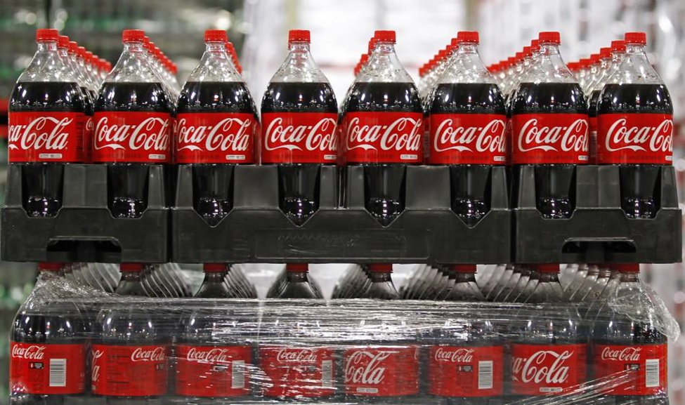
Coca cola drinks
Notes:
This is an example of a Coca cola product stored in plastic bottles. Coca cola is one of the largest companies producing soft drinks in the wold.

Slide 12
Advertising in schools
Many schools are opposed to the advertisement of soft drinks around the school compounds.
School nutrition is an important focus of legislative initiatives targeting the causes of obesity. As a result, many schools in America have refused to enter into deals with soft drink companies after protests from students, school officials, and parents.
The Oakland school district banned all sales of soda and candy in 2002. Los Angeles school board decided to remove the soft drinks off cafeteria menus and end the selling if soft drinks in vending machines by 2004.
These actions are aimed at ousting soft drinks from schools. Such actions are likely to decrease soft drink companies’ support for schools although contracts with soda companies are significant sources of income for these schools.
Notes:
School nutrition is an important focus of legislative initiatives targeting the causes of obesity. As a result, many schools in America have refused to enter into deals with soft drink companies after protests from students, school officials, and parents. Many schools are opposed to the advertisement of soft drinks around the school compounds.
The Oakland school district banned all sales of soda and candy in 2002. Los Angeles school board decided to remove the soft drinks off cafeteria menus and end the selling if soft drinks in vending machines by 2004. These actions are aimed at ousting soft drinks from schools.

Slide 13
Health and advertising
Since soft drinks are associated with health problems like obesity especially in children, adverts aim at maintaining the health and nutrition of such drinks.
Most of the soft drinks including juices, carbonated drinks and sports and energy drinks have high sugar content and acidity.
Most of them also have little nutritional values and lack micro-nutrients, vitamins and minerals.
Thus, there are efforts by the governments to reduce the potential harmful effects of soft drinks on teeth and general health. Health concerns have made government agencies to restrict soft drink advertisement.
Notes:
Since soft drinks are associated with health problems like obesity especially in children, adverts aim at maintaining the health and nutrition of such drinks.
Most of the soft drinks including juices, carbonated drinks and sports and energy drinks have high sugar content and acidity with little nutritional values. Thus, there are efforts by the governments to reduce the potential harmful effects of soft drinks on teeth and general health. Health concerns have made government agencies to restrict soft drink advertisement.

Slide 14
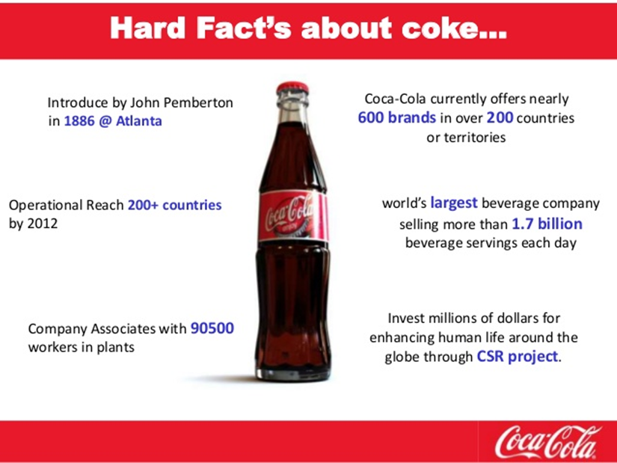
Political advertising of soft drinks
Soft drinks are advertised through newspaper ads, articles, radio, television, social media, and other means of mass communication.
Notes:
This is an example of political advertisement of soft drinks. The poster gives some facts about Coca cola company like the number of brands it offers and its Corporate Social Responsibility (CSR) projects.

Slide 15
Example of a commercial-Coke “taste the feeling”
Unusual elements
The unusual elements of this commercial is kissing especially in the library.
Target group
The target group of the ad is the youth or the millennials. The ad targets young people (boys and girls) having fun and partying.
The ad promotes the lifestyle of fun and hip, which is mostly enjoyed by the young generation.
The youth is looking for fun and excitement and throwing boredom away. Kissing brings the feeling of joy and excitement.
Notes:
One commercial that strikes me is Coca cola’s “Taste the feeling” ad. I like the creativity and appeal found in this advert. The unusual element I find in this ad is kissing in the library. The target group of this ad is the youth (millennials). The ad targets young people (boys and girls) who are seen having fun and partying. The youth is looking for fun and excitement and throwing boredom away. Kissing brings the feeling of joy and excitement.

Slide 16
How does the commercial appeal to consumers?
The commercial appeal used in the ad is pathos. A song plays from the background throughout the ad.
The ad also uses pathos by arousing the feelings of consumers by insinuating that wonderful moments are only enjoyed with coca cola.
The ad brings the feelings of love (kissing), joy, fun, and excitement and this aims at winning the audience through emotions.
Logos is also used to convince the audience by the virtue of Coca Cola’s taste which the advert insinuates that it is the best. No drink is better than Coca cola to quench your thirst.
Notes:
The ad uses both pathos and logos to appeal to the audience. Pathos is used by arousing the feelings of consumers by insinuating that wonderful moments are only enjoyed with coca cola. The ad brings the feelings of love (kissing), joy, fun, and excitement and this aims at winning the audience through emotions. Also, a song plays in the background throughout the ad. Logos is also used to convince the audience by the virtue of Coca Cola’s taste which the advert insinuates that it is the best. No drink is better than Coca cola to quench your thirst.

Slide 17
Why do you believe this commercial to be effective in brand name recognition?
I believe commercial is effective in Coca cola’s recognition because, throughout the ad, the label of Coca Cola appears several times, a strategy that is used to drive recognition. The structure of the ad is very convincing as drinking coca cola drinks brings wonderful moments of friendship.
The use of young people in the ad also significant in the ad because the ad is targeting the youth. Therefore, the ad is very likely to win many young customers leading to brand recognition.
Also, I believe this commercial is effective in Coca cola’s recognition because Coke is presented as the best drink ever.
Notes:
I believe this commercial is effective in brand name recognition because the label Coca Cola appears repeatedly throughout the ad. This strategy is used to drive recognition. The use of young people in the ad also significant in the ad because the ad is targeting the youth. Therefore, the ad is very likely to win many young customers leading to brand recognition.

Slide 18
How are ethical standards met (or pushed to their limits)?
Although there is kissing in the ad, it is between a boy and a girl meaning that the morals of same sex marriage is discouraged in the ad.
The advert however depicts a lot of romance and sex as it shows a boy and a girl kissing in a library.

Slide 19
References
Ludwig, D. S., Peterson, K. E., & Gortmaker, S. L. (2001). Relation between consumption of sugar-sweetened drinks and childhood obesity: a prospective, observational analysis. The Lancet, 357(9255), 505-508.
Severson, K. L. A., & Chronicle, S. F. (2002). Schools to stop soda sales; district takes cue from Oakland ban. San Francisco Chronicle, 28.

